Slide 1
Housing price prediction
Summitted by:-
Pooja jaswal

Slide 2
Introduction
Business Problem Framing
Houses are one of the necessary need of each person around the globe and therefore housing and real estate market is one of the markets which is one of the major contributors in the world’s economy. It is a very large market and there are various companies working in the domain. Data science comes as a very important tool to solve problems in the domain to help the companies increase their overall revenue, profits, improving their marketing strategies and focusing on changing trends in house sales and purchases. Predictive modelling, Market mix modelling, recommendation systems are some of the machine learning techniques used for achieving the business goals for housing companies. Our problem is related to one such housing company. A US-based housing company named Surprise Housing has decided to enter the Australian market. The company uses data analytics to purchase houses at a price below their actual values and flip them at a higher price. For the same purpose, the company has collected a data set from the sale of houses in Australia.
This is a real estate problem where a US based housing company named Surprise Housing has decided to invest in Australian Market. Their agenda is to buy houses in Australia at prices below their actual value in the market and sell them at high prices to gain profit. To do this this company uses data analytics to decide in which property they must invest. Company has collected the data of previously sold houses in Australia and with the help of this data they want to know to the value of prospective properties to decide whether it will be suitable to invest in the properties or not.

Slide 3
Conceptual Background of the Domain Problem
The value of property also depends on the proximity of the property, its size its neighbourhood and audience for which the property is subjected to be sold. For example, if audience is mainly concerned of commercial purpose. Then the property which is in densely populated area will be sold very fast and at high prices compared to the one located at remote place. Similarly, if audience is concerned only on living place, then property with less dense area having large area with all services will be sold at higher prices.
The company is looking at prospective properties to buy houses to enter the market. We are required to build a model using Machine Learning in order to predict the actual value of the prospective properties and decide whether to invest in them or not.

Slide 4
Review of Literature
House is one of human life's most essential needs, along with other fundamental needs such as food, water, and much more. Demand for houses grew rapidly over the years as people's living standards improved. While there are people who make their house as an investment and property, yet most people around the world are buying a house as their shelter or as their livelihood.
We are required to build a model using Machine Learning in order to predict the actual value of the prospective properties and decide whether to invest in them or not.

Slide 5
Motivation for the Problem Undertaken
Houses are one of the necessary need of each person around the globe and therefore housing and real estate market is one of the markets which is one of the major contributors in the world’s economy. It is a very large market and there are various companies working in the domain. Data science comes as a very important tool to solve problems in the domain to help the companies increase their overall revenue, profits, improving their marketing strategies and focusing on changing trends in house sales and purchases. Predictive modelling, Market mix modelling, recommendation systems are some of the machine learning techniques used for achieving the business goals for housing companies. Our problem is related to one such housing company. To understand real world problems where Machine Learning and Data Analysis can be applied to help organizations in various domains to make better decisions with the help of which they can gain profit or can be escaped from any loss which otherwise could be possible without the study of data .One of such domain is Real Estate.

Slide 6
Analytical Problem Framing
Mathematical/ Analytical Modelling of the Problem
In Housing Price Prediction project, we have performed various mathematical and statistical analysis such as we checked description or statistical summary of the data using describe, checked correlation and visualized it using heatmap then we have used Z-Score to plot outliers and remove them.

Slide 7
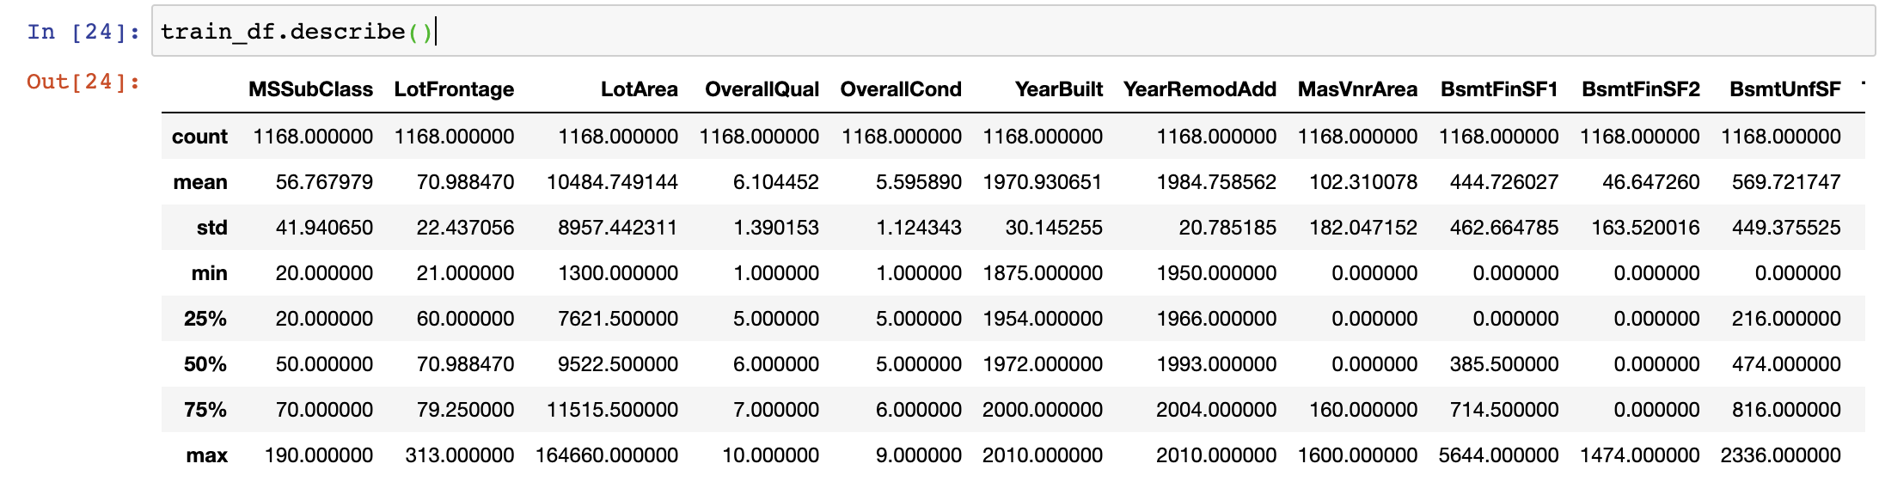
In the columns Id, MSSubclass, LotArea, MasVnrArea, BsmtFinSF1, BsmtFinSF2, BsmtUnfsF, TotalBsmtSF, 1stFlrSF, 2ndFlrSF, LowQualFinSF, GrLivArea, BsmtFullBath, HalfBath, TotRmsAbvGrd, WoodDeckSF, OpenPorchSF, EnclosedPorch, 3SsnPorch, ScreenPorch, PoolArea, Miscval, salePrice mean is considerably greater than median so the columns are positively skewed.
In the columns FullBath, BedroomAbvGr, Fireplaces, Garagecars, GarageArea, YrSold Median is greater than mean so the columns are negatively skewed.
In the columns Id, MSSubClass, LotFrontage, LotArea, MasVnrArea, BsmtFinSF1, BsmtFinSF2, BsmtUnfSF, TotalBsmtSF, 1stFlrSF, 2ndFlrSF, LowQualFinSF, GrLivArea, BsmtHalfBath, BedroomAbvGr, ToRmsAbvGrd, GarageArea, WoodDeckSF, OpenPorchSF, EnclosedPorch, 3SsnPorch, ScreenPorch, PoolArea, MiscVal, SalePrice there is considerable difference between the 75 percentile and maximum, so outliers are present.

Slide 8
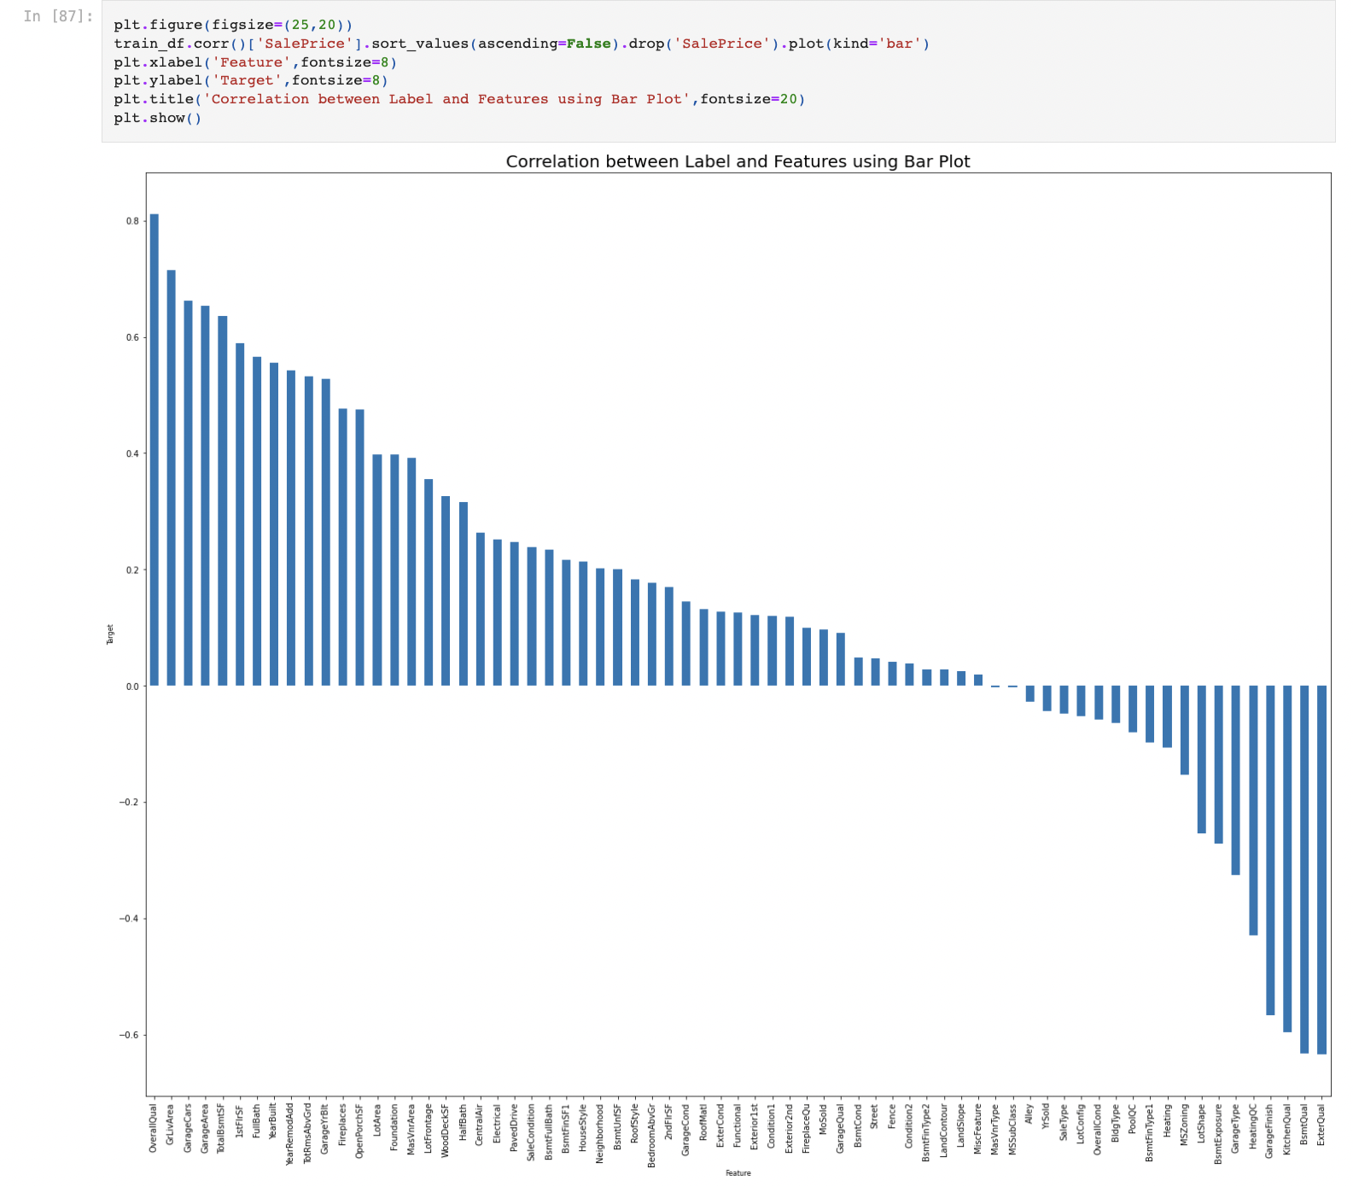
Data Inputs- Logic- Output Relationships
Here we check the correlation between all our feature variables with target variable label
1. The column OverallQual is most positively correlated with SalePrice.
2. The column KitchenAbvGrd is most negatively correlated with SalePrice.

Slide 9
Set of assumptions related to the problem under consideration
Here we have observed that only one single unique value was present in Utilities column so we assumed that we will be dropping these columns. We have also observed multicollinearity in between columns so we assumed that we will be using Principal Component Analysis.
By looking into the target variable label, we assumed that it was a Regression type of problem.

Slide 10
Model/s Development and Evaluation
Identification of possible problem-solving approaches (methods)
We have observed skewness in data, so we tried to remove the skewness through treating outliers with technique. We first converted all our categorical variables to numeric variables with the help of dummy variables to checkout and dropped the columns which we felt were unnecessary. The data was improper scaled, so we scaled the feature variables on a single scale using sklearn’s StandardScaler package

Slide 11
Testing of Identified Approaches (Algorithms)
The algorithms we used for the training and testing are as follows:-
Random Forest Regressor
SVR
Linear Regressor
SGD Regressor
KNeighbors Regressor
Gradient Boosting Regressor

Slide 12
Interpretation of the Results
From the preprocessing we interpreted that data was improper scaled. From the visualization we interpreted that the target variable SalePrice was highly positively correlated with the columns GrLivArea, YearBuilt, OverallQual, GarageCars, GarageArea.

Slide 13
CONCLUSION
Key Findings and Conclusions of the Study
Housing Price Prediction here we have tried to show how the house prices vary and what are the factors related to the changing of house prices. The best RMSE score was achieved using the best parameters of Ridge Regressor through GridSearchCV though Lasso Regressor model performed well too.

Slide 14
Learning Outcomes of the Study in respect of Data Science
With the help of different powerful tools of visualization, we were able to analyse and interpret different hidden insights about the data. This project has demonstrated the importance of sampling effectively, modelling and predicting data. Through data cleaning we were able to remove unnecessary columns and outliers from our dataset due to which our model would have suffered from overfitting or underfitting.
The few challenges while working on this project where:-
Improper scaling
Too many features
Missing values
Skewed data due to outliers
There were lot of missing values present in different columns which we imputed on the basis of our understanding. The data was improper scaled, so we scaled it to a single scale using sklearns’s package StandardScaler.

Slide 15
Limitations of this work and Scope for Future Work
The very nature of this project allows for multiple algorithms to be integrated together as modules and their results can be combined to increase the accuracy of the result. This model can further be improved with the addition of more algorithms into it. However, the output of these algorithms needs to be in the same format as the others. Once that condition is satisfied, the modules are easy to add as done in the code. This provides a great degree of modularity and versatility to the project. While we couldn’t reach out goal of minimum RMSE in house price prediction without letting the model to overfit, we did end up creating a system that can with enough time and data get very close to that goal. As with any project there is room for improvement here.

